Slide 1
DESIGN AND SIMULATION OF RESONANT INDUCTIVE COUPLING WIRELESS POWER TRANSFER SYSTEM FOR ELECTRIC VEHICLES APPLICATIONS

Slide 2
OUTLINE ABOUT PROJECT
This research focuses on the study of using an inductive-coupled Wireless Power Transfer (WPT) system for electric vehicle charging applications in Medium Voltage DC (MVDC) power networks. Implementing WPT in Electric Vehicles (EVs) can provide a convenient alternative charging option, versus static charging in a station that would take hours. Also, it can prevent the potential of electrocution hazards that might occur due to the usage of physical medium like wires in EV charging.

Slide 3
Even though inductive coupling has been applied in some applications of WPT, it is still not efficient enough to transfer high power at the kilowatts level due to weak coupling between the transmitter and the receiver. Using optimally-specified resonant circuits along with inductive coupling can enhance the coupling and make the system more efficient for practical applications.
This research aims to design and analyze the performance of a 5-KW WPT circuit. The optimal specification of a resonant circuit is studied and discussed. Theoretical calculations are performed to find the component values in the circuit to reach. The WPT system is firstly verified by performing simulation tests in the MATLAB/SIMULINK environment and then on a low power hardware.

Slide 4
INTRODUCTION
Since a few decades ago, the use of Electric Vehicles (EVs) has increased due to the advantages they possess when compared to Internal Combustion Engine (ICE) vehicles. The former have much less carbon emission, which prevents global warming to a considerable extent. Since the invention of EVs, they have gone through many stages of transformation in terms of their design topology and in-built technology. The aim of this thesis is to design and analyze an inductive coupled wireless power transfer (WPT) topology for EVs to integrate with Medium Voltage DC (MVDC) networks. The main focus of the design will be on studying and analyzing a resonant circuit topology to apply to the wireless inductive power transfer (IPT) design.

Slide 5
The charging time for EVs was nearly 8 hours or more, which is very long. The cost of EVs was 40% more compared to ICE vehicles.
Besides buying an EV, operating and maintenance costs were high compared to ICE vehicles.
Even though there was no proof that EVs are less safe compared to ICE vehicles, automobile manufacturers hesitated to spend money in research, development and manufacturing of EVs as there was a downfall in the market by that time.
In the 1990s lead acid batteries were used in most of EVs which made the vehicle very heavy and required a long battery charging time. Also, there was no good infrastructure to recharge EVs.
Even the prices of hybrid electric vehicles (HEVs) and Plug in Hybrid Electric Vehicles (PHEVs) were higher compared to gasoline based ones.

Slide 6
RESONANT CIRCUITS OF INDUCTIVE WPT SYSTEM
Resonant Inductive power transfer: the resonance property, magnetic resonance coupling is immune to the neighboring environment. In an IPT system without resonance, the power transfer between the transmitter and receiver can decrease if there is a misalignment in the positions of primary and secondary coils, but inclusion of resonant circuits can give flexibility in the orientation between the source and load during the operation

Slide 7
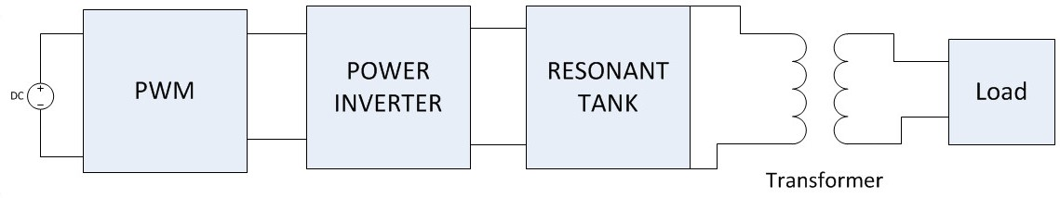
5 KW IPT system design approach:
PWM Module: The system consists of a PWM module, which consists of two circuits that generate pulses to control the switches in the inverter. These two circuits are:
Controller IC
Driver circuit.

Slide 8
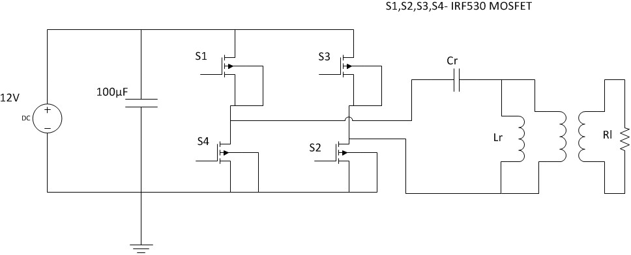
Main circuit of 5KW system:
S1 | S2 | S3 | S4 | Vo (Inverter output voltage)
ON | ON | OFF | OFF | Vin
ON | OFF | ON | OFF | Zero
OFF | OFF | ON | ON | -Vin
OFF | ON | OFF | ON | Zero

Slide 9
A Design of Inductive Coupling Wireless Power Transfer System for Electric Vehicle Applications
Specifications of 5KW system.
Parameter | Value
Input Voltage | 120 V
Power Rating | 5KW
Operating Frequency | 50kHz
Quality Factor | 5
Output voltage | 400 V
Turns ratio | 2.5

Slide 10
Calculated values of 5KW system:
Parameter | Value
Voltage across the Capacitor | 600 V (rms) , 848.528 V(peak)
Voltage across the Inductor | 611.88 V (rms) , 865.3323 V (peak)
Value of Inductance | 0.0476669 Mh
Value of Capacitance | 0.22106 µF
Total Input Current | 41.669 A(rms)
Current through the Inductor | 40.86 A(rms)
Current through the Capacitor | 41.669 A(rms)

Slide 11
L and C values for different frequencies:
Output voltages for different turns ratios:
Frequency | Value of Inductance | Value of Capacitance
20kHz | 0.11916 mH | 0.552658 µF
30kHz | 0.0794448 mH | 0.368438 µF
50kHz | 0.0476669 mH | 0.22106 µF
Turns Ratio | Output Voltage
1 | 611.8823 V (rms)
1.5 | 407.921 V (rms)
2 | 305.94117 V (rms)
2.5 | 244.7529 V (rms)

Slide 12
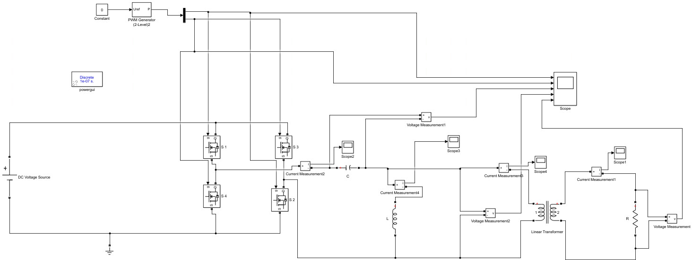
Simulation Results for 5KW system

Slide 13
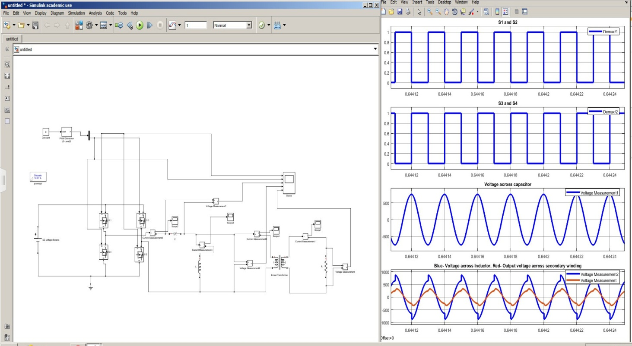

Slide 14
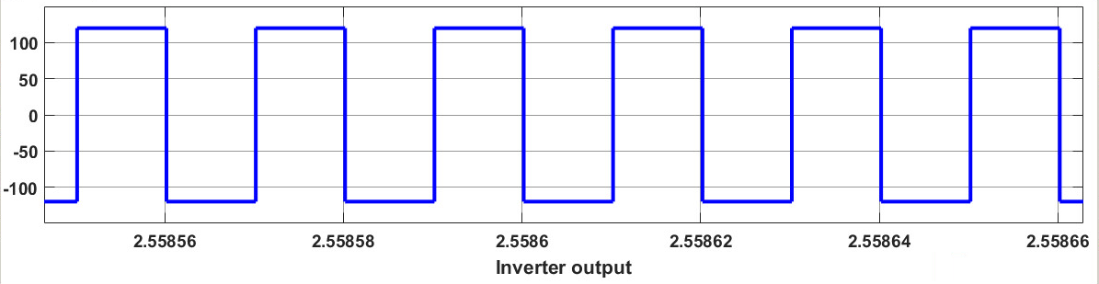
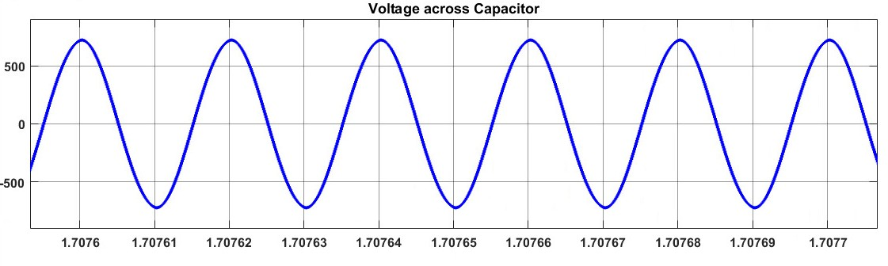
Output of inverter:
Output of voltage across capacitor:

Slide 15
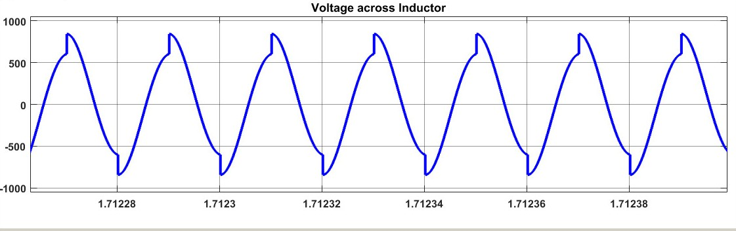
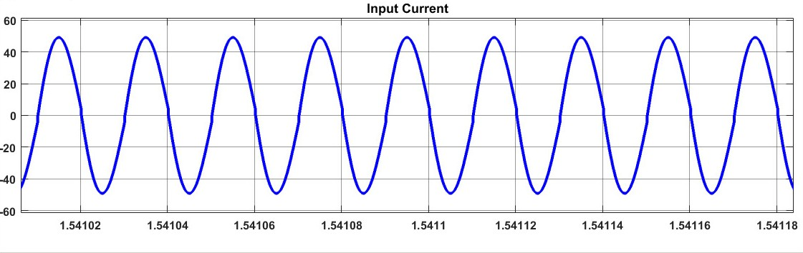
Output of Voltage across Inductor:
Input current:

Slide 16
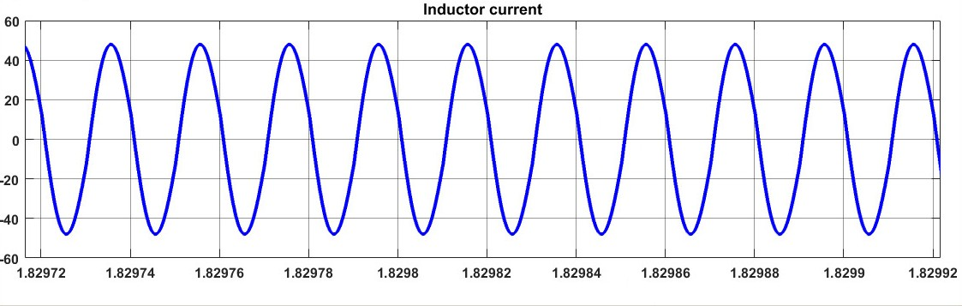
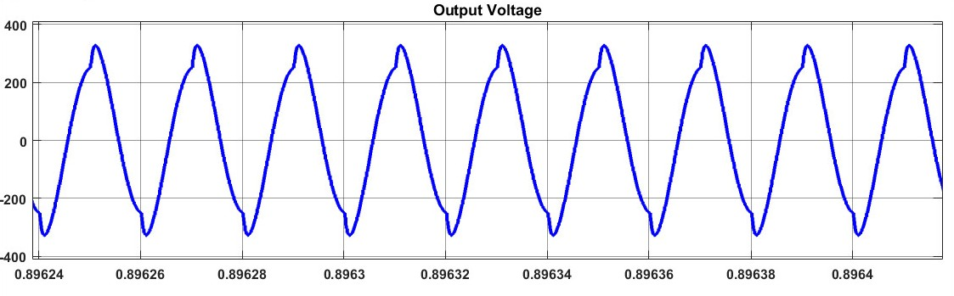
Current through Inductor:
Output Voltage across secondary winding:

Slide 17
CONCLUSION AND FUTURE WORK
Conclusion: A 5KW Inductive power transfer system for electric vehicle applications in MVDC networks is designed and analyzed. According to the specifications of the system, the design is observed to show good performance at a turns ratio of 2.5. When the turns ratio is decreased beyond 2.5, the Quality factor of the system fell below the desired value. Also, the voltage across the resonant Inductor and Capacitor declined. If the Quality factor of the system and the voltage on the transmitting side decreases, the performance of the system drops as the transmitter’s ability to transfer energy onto the secondary side also drops.

Slide 18
The coupling distance also cannot be varied to a long range with a decrease in performance. Hence, it can be concluded that this proposed system, when designed with a turns ratio of 2.5, produced the desired results validated by simulation results, so this system is useful for practical applications.
Future Work: Since hardware tests were done on a low-power test bed, future work should focus on implementing the high-power hardware testbed and testing its performance.

Slide 19
PRESENTED BY:
KRISHNA KUMAR SHARMA
0601EE171022

Slide 20
THANK YOU

